Slide 1

ENTERPRISE SOFTWARE DEVELOPMENT

Slide 2
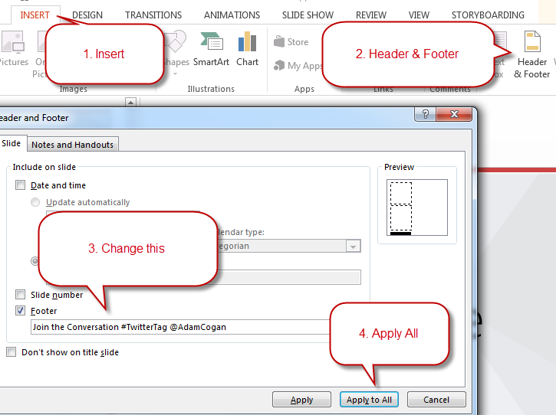
Change the Footer
Make sure you don’t forget the footer. Everyone forgets the footer.

Slide 3
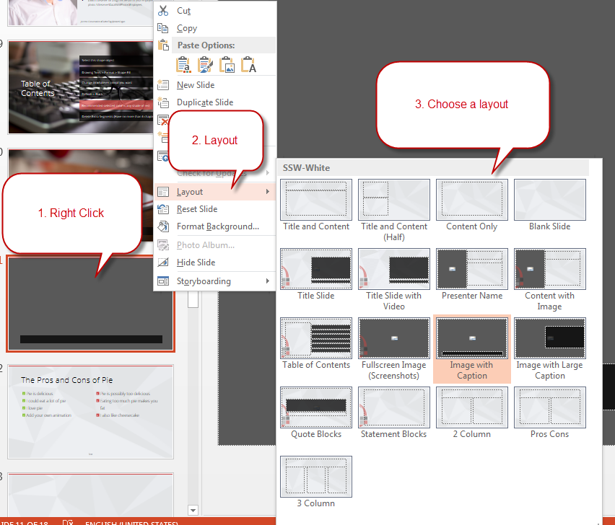
Use Different Slide Layouts
Make sure you’re using the template correctly with slide layouts.

Slide 4
SSW Template
Version 4.0 by SSW Design Tip: Slides have additional info in View | Notes.
Notes:
V4.0 Beautified by Jayden

Slide 5
















Icon Library
These icons are pulled from http://fontawesome.com
Feel free to use your own by pasting in any SVG. You can use PowerPoint to recolor SVGs (Right Click > Fill).

Slide 6




Other Icons
Here are some little red people and other items!
ssw.com.au/rules/do-you-use-standard-question-mark-when-you-are-going-to-ask-the-audience-something
Question Man Demo Man Bad Example Good Example

Slide 7

Adding logo watermark
If you want the logo overlap as shown in the template, you’ll need the logo in the bottom right of this slide. Just copy paste it onto relevant slides.

Slide 8


Common mistakes in EF Core
V3.2
SSW .NET User Group 2021

Slide 9

V3.5

Slide 10






Jernej Kavka (JK)
SSW Solution Architect
@Jernej_kavka
github.com/jernejk
jkdev.me
linkedin.com/in/jernejkavka/
Organizer of AI events
.NET Core and EF Core dev specialist
Cognitive Services and ML․NET enthusiast🦸‍♂️

Slide 11
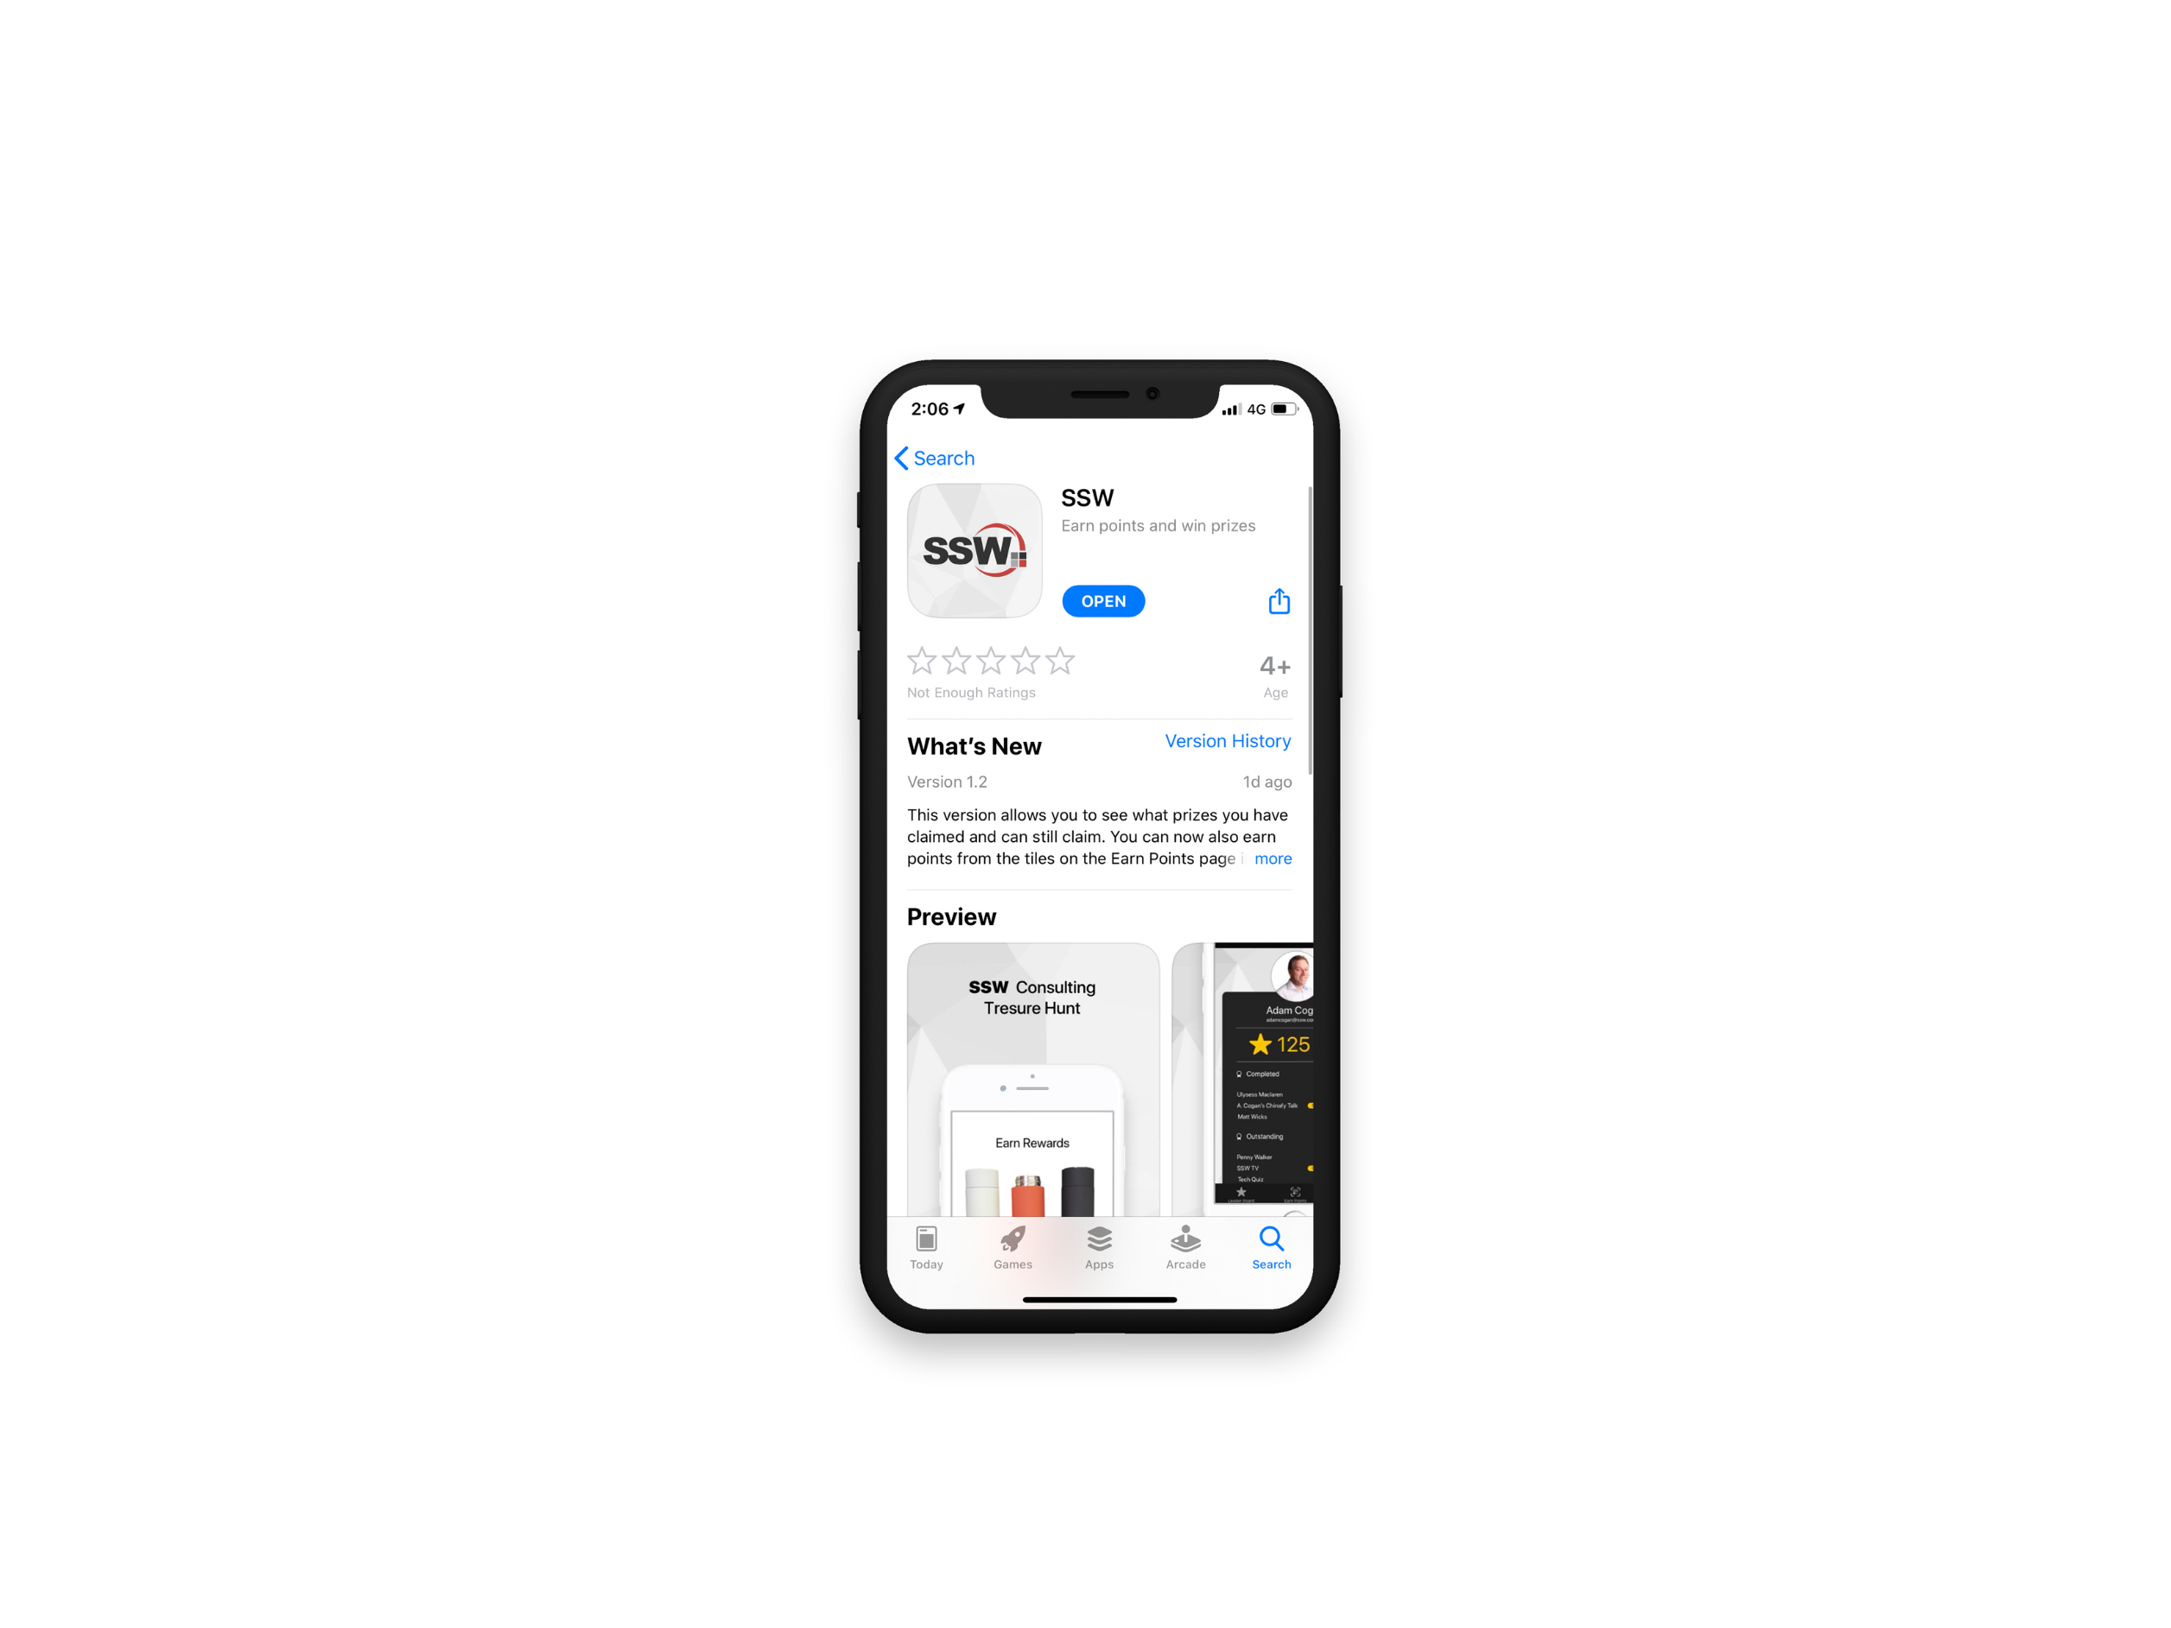

Scan QR Code to install app
Scan SSW codes at talks and events
Earn SSW Points
claim rewards, and win prizes
SSW Rewards
Notes:
An SSW Admin will give you your QR code https://my.sugarlearning.com/SSW/items/13946/ssw-rewards-setup-the-ssw-rewards-app

Slide 12


Agenda
Intro
The 7 Deadly Sins
Mini Best Practices

Slide 13
We have lots of DB engines Data access landscape
SQL Server
Cosmos DB
PostgreSQL
mySQL
…

Slide 14
Various ORM
EF Core (multiple DBs)
Dapper (SQL Server/EF Core)
Marten (PostgreSQL)
Cosmos DB SDK
…

Slide 15
Why EF Core
Great balance
Features
Flexibility
Performance
Awesome for relational DBs
Built-in migrations, DB scaffolding and other tooling

Slide 16
Avoid the pain
“EF Core is slow”
If you write bad code
“Code looks bad”
If you write bad code
“No guides to write good EF queries”
Using the best practices
Benchmark your code with tests
The horror I have seen… 😱
Notes:
I’m EF guy at SSW
Help them out with code
Help with best practices

Slide 17
Avoid the pain
The EF Core issues that are solved
Simplifying your code
Benchmark your code with tests
The horror I have seen… 😱
Notes:
I’m EF guy at SSW
Help them out with code
Help with best practices

Slide 18


Benchmark tools
BenchmarkDotNet
Memory consumption and time difference
Bombardier
Simple CLI load testing tool

Slide 19

Benchmark tools
BenchmarkDotNet
Memory consumption and time difference
Bombardier
Simple CLI load testing tool
NBomber
Automating load tests

Slide 20
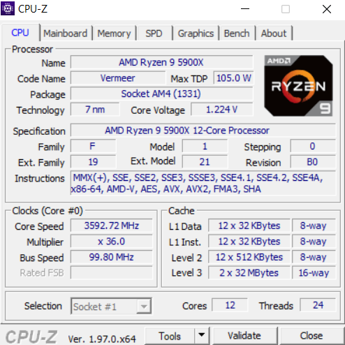
My testing environment
.NET 6 with EF Core 6
My beefy PC
CPU: Ryzen 9 5900X
Cores: 12
Threads: 24
Ram: 32GB

Slide 21
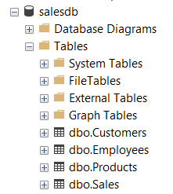
Test data
7 million sales
504 products
23 employees
20,000 customers
https://www.sqlskills.com/sql-server-resources/sql-server-demos/

Slide 22

The 7 Deadly Sins

Slide 23
The 7 Deadly EF Core Sins (easy to hard)
🚀 Get only the rows that you need (obvious)
🚀 Casting IQueryable -> IEnumerable
🚀 Not using AsNoTracking
🚀 Explicit joins
🚀 Get only columns you need (should be obvious)
🚀 Pagination
💪 Non-cancellable queries

Slide 24
Common EF mistakes (easy to hard)
🚀 Get only the rows that you need (obvious)
🚀 Casting IQueryable -> IEnumerable
Not using AsNoTracking
Get only columns you need (should be obvious)
Explicit joins
🚀 Pagination
🚀 Overly complex queries
💪 Non-cancellable queries

Slide 25
How bad can it be? (you never want the answer to this)
Literally everyone before discovering horrifying truth ☺

Slide 26
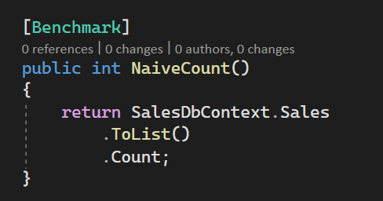
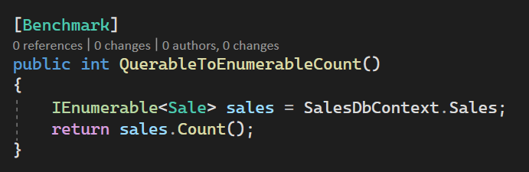
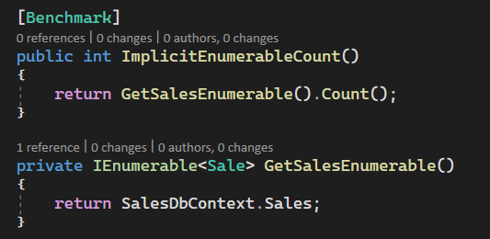
#2 Counting
⚠️
THEY ARE ALL THE SAME

Slide 27
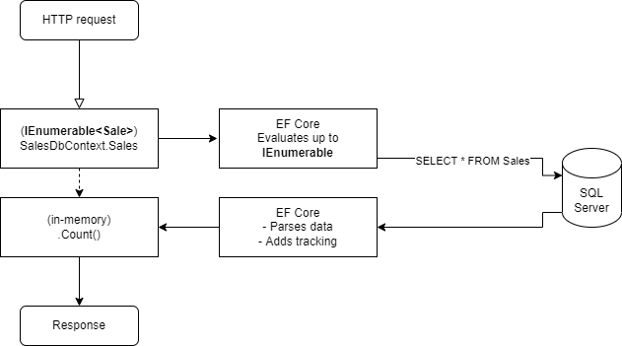
#2 What is going on?

Slide 28
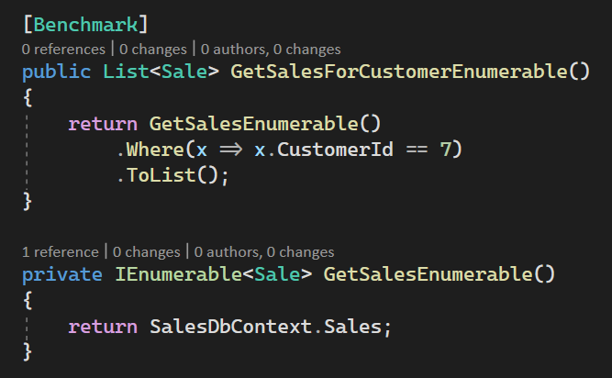
#2 Naïve where

Slide 29
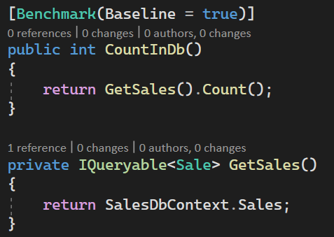
#2 IQueryable

Slide 30
#2 What is going on?
Gets entire table
Everything is tracked in EF Core
Consumes additional CPU and memory
Query is processed in-memory
All data is discarded
Garbage Collection is doing overtime

Slide 31
#2 Impact
For 7 million rows with 5 integers
4 bytes * 5 * 7 million = ~140MB
Tracking adds ~4 bytes per property per row
Minimum consumption: ~280MB per call
Is slow and uses a lot of CPU!

Slide 32
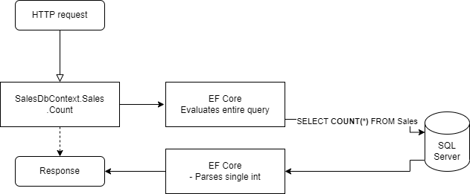
#2 How is this better?

Slide 33
IQueryable + EF Core (EF Core LINQ) ≠ IEnumerable (Standard LINQ)

Slide 34
#2 Solution
Always use IQueryable (when possible)
Prevents premature requests to DB

Slide 35
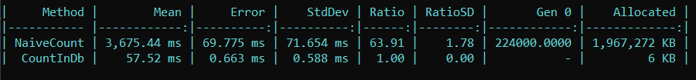
#2 What is the memory impact?
Full 3.5 seconds faster!
64 times faster
~million times
less memory

Slide 36
#2 What about load testing?
~260x faster on average in a load test!

Slide 37
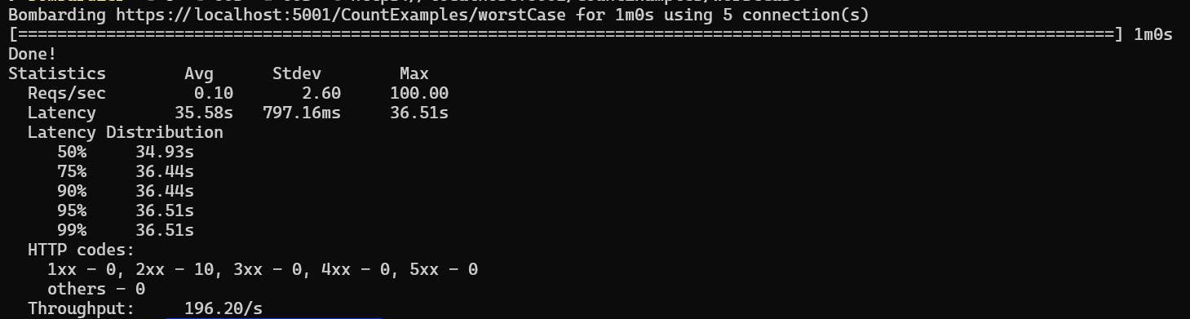
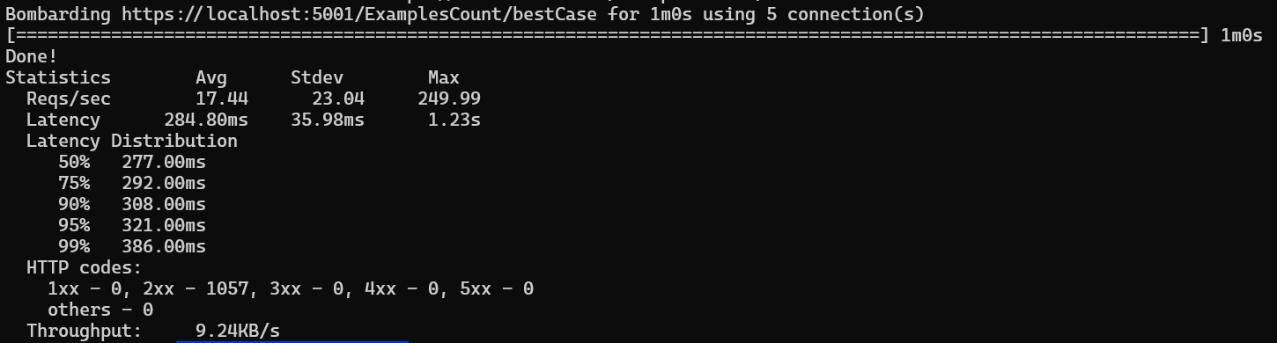
#2 The difference - Bombardier
174 times faster in load testing!

Slide 38
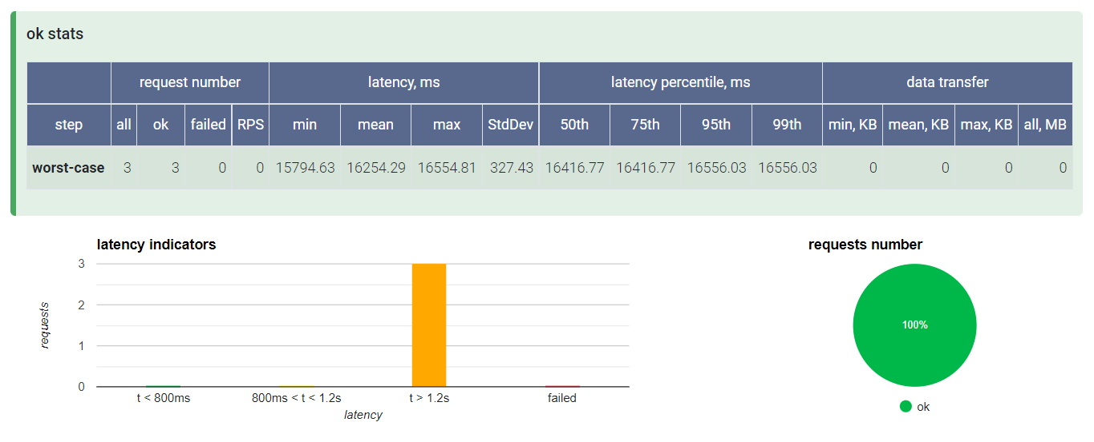
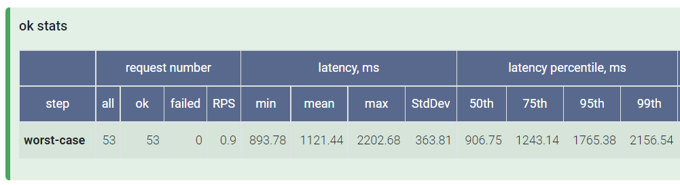
TODO: NBomber – real data

Slide 39
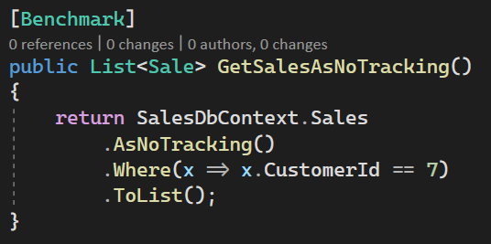
#3 AsNoTracking
Exclude tracking on entities
Less memory and CPU usage
Changes to the entities are not tracked

Slide 40
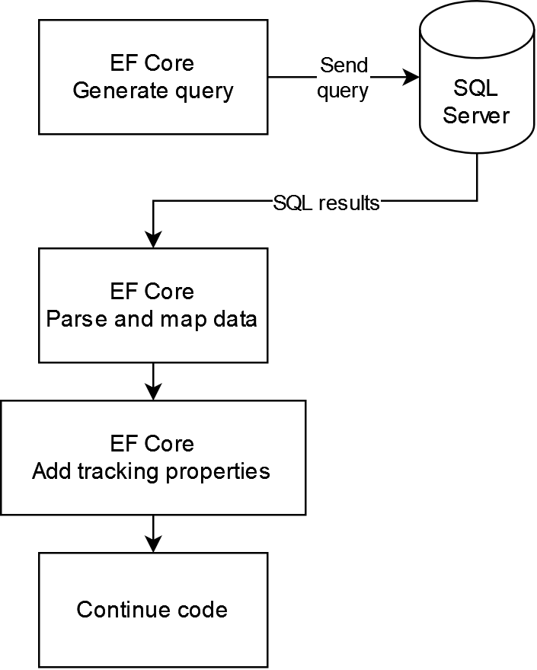
#3 What is happening?
Default
AsNoTracking
Additional property
for every row and column
used by
DbContext.SaveChangesAsync

Slide 41
#3 What is the impact?
~1.6 seconds faster!
~5 times faster
~4x less memory

Slide 42
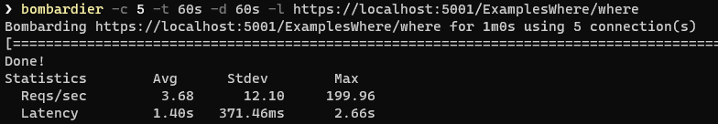
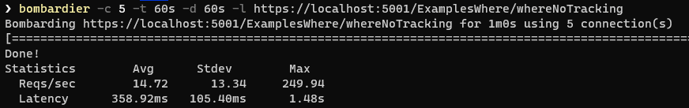
#3 What about load testing?
~4x faster on average in a load test!

Slide 43
#4 Explicit includes
.Include(x => x.Customers)
They are always included even if not needed
Devs often forget to remove them
We get all columns even if we don’t need them

Slide 44
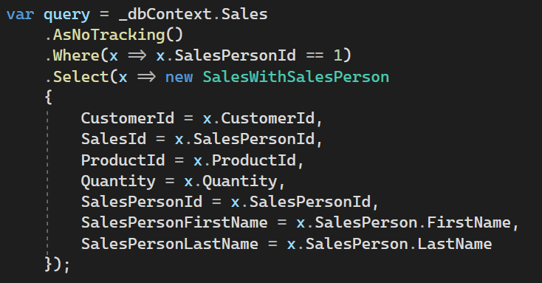
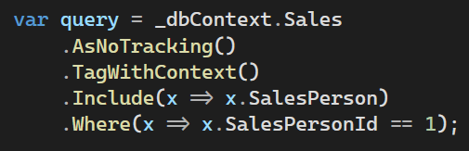
#4 & #5 Implicit includes with Select

Slide 45
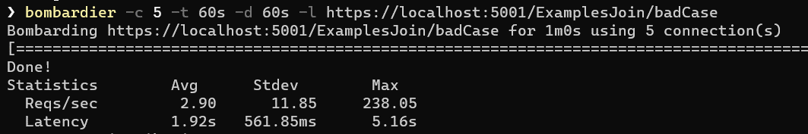
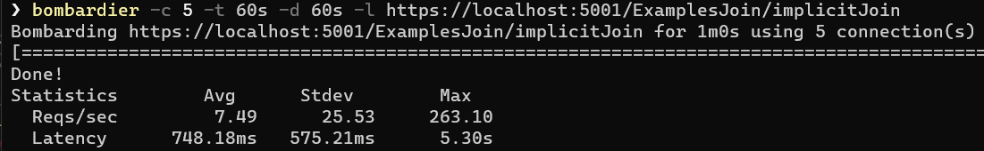
#4 & #5 Load Test
~2.5x faster on average in a load test!

Slide 46
Demo

Slide 47
#6 Common Pagination issues
Inefficient code
Filter data
Get all filtered data
Count them
Apply Take and Skip in-memory for pagination

Slide 48
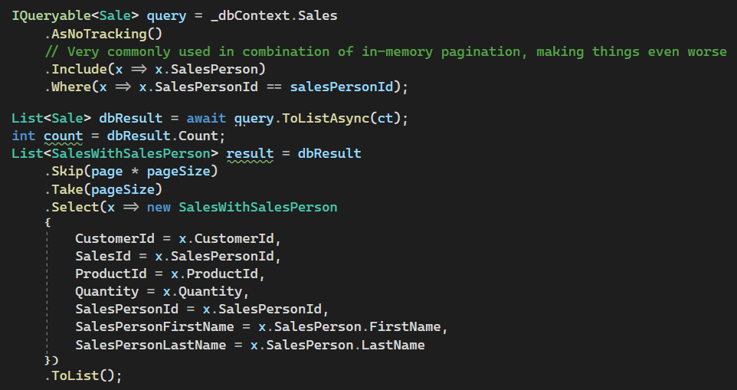
#6 Pagination code – naïve
Gets all filtered data
Count in-memory
Pagination is done
In-memory

Slide 49
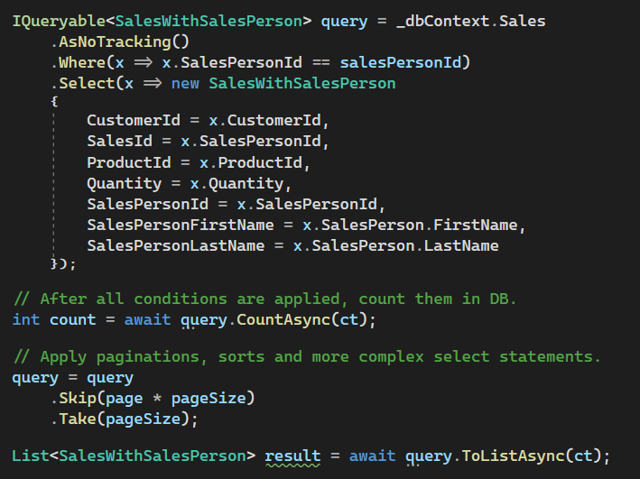
#6 Pagination code – improved
We are preparing the query
For counting and pagination
Count in SQL Server
Pagination is done
on SQL Server

Slide 50
Demo

Slide 51
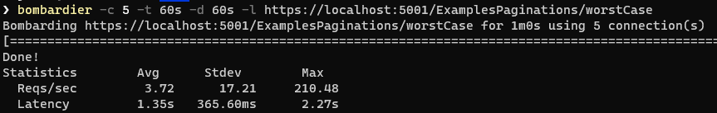
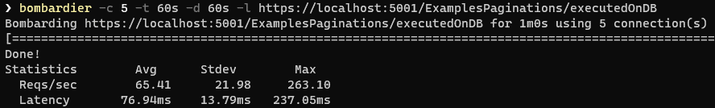
#6 Load test
~18x faster on average in a load test!

Slide 52
#7 Over complicated queries
Too many includes
Too much data
Lots of repeating data in the joined tables
Data that can be prefetched
Overly complex filtering

Slide 53
Demo

Slide 54
#7 Non-cancellable queries
When query is running on SQL Server
It will run until completion
Complex queries can stuff up SQL Server

Slide 55
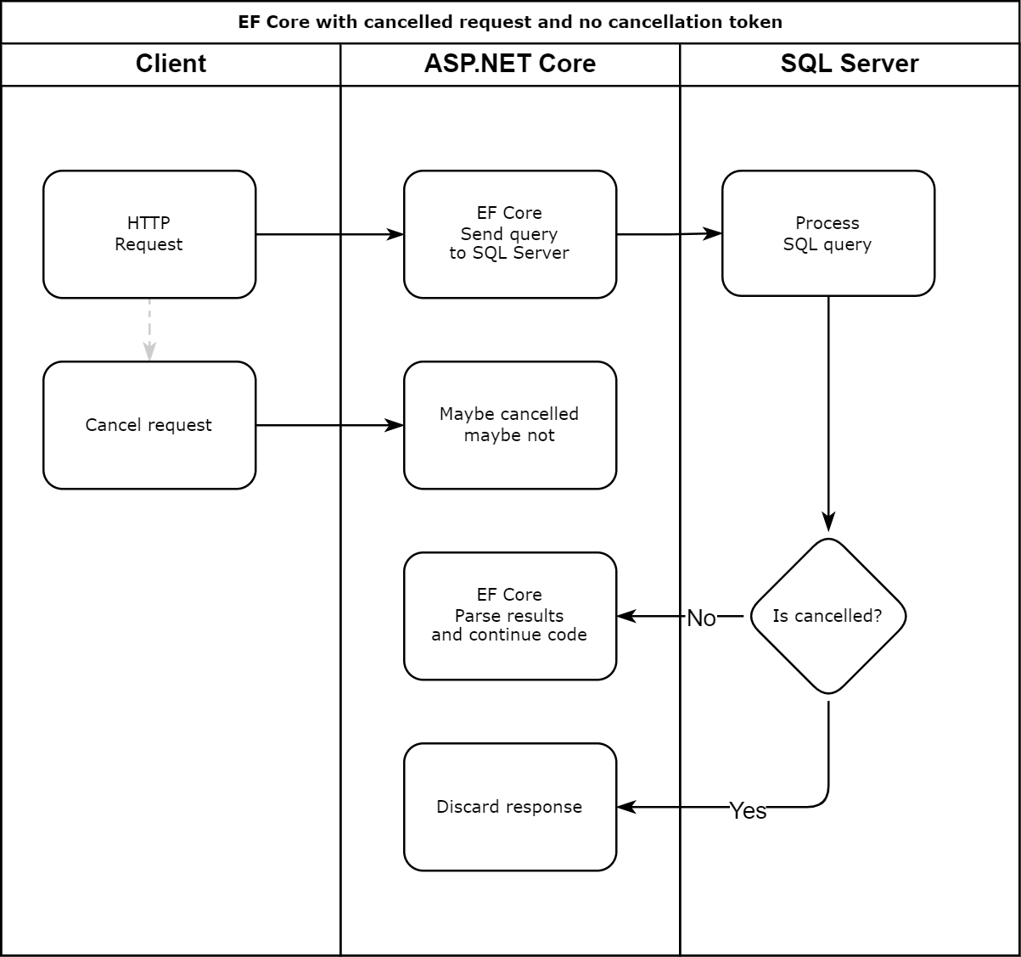

#7 What’s the problem?

Slide 56
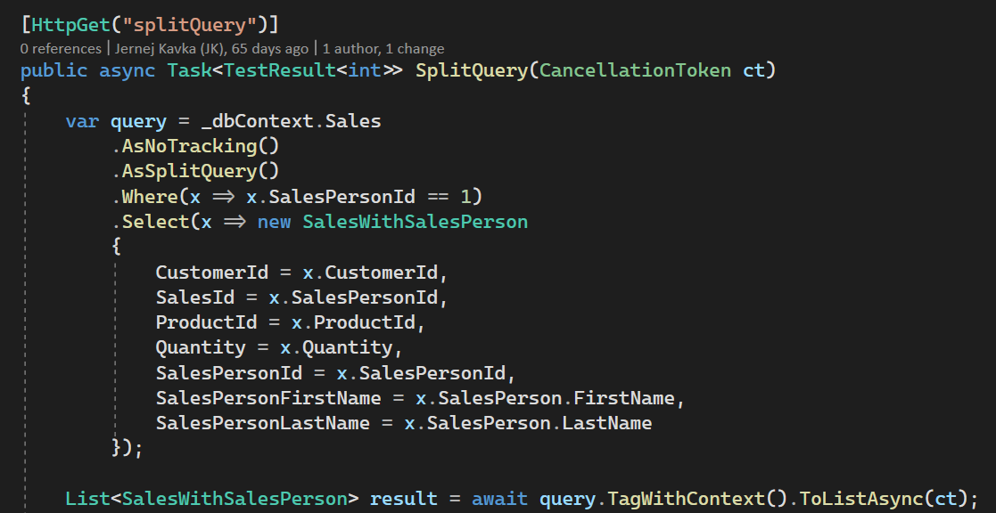
#7 Async and CancellationToken
Stop execution on the server when cancelled

Slide 57
Demo

Slide 58
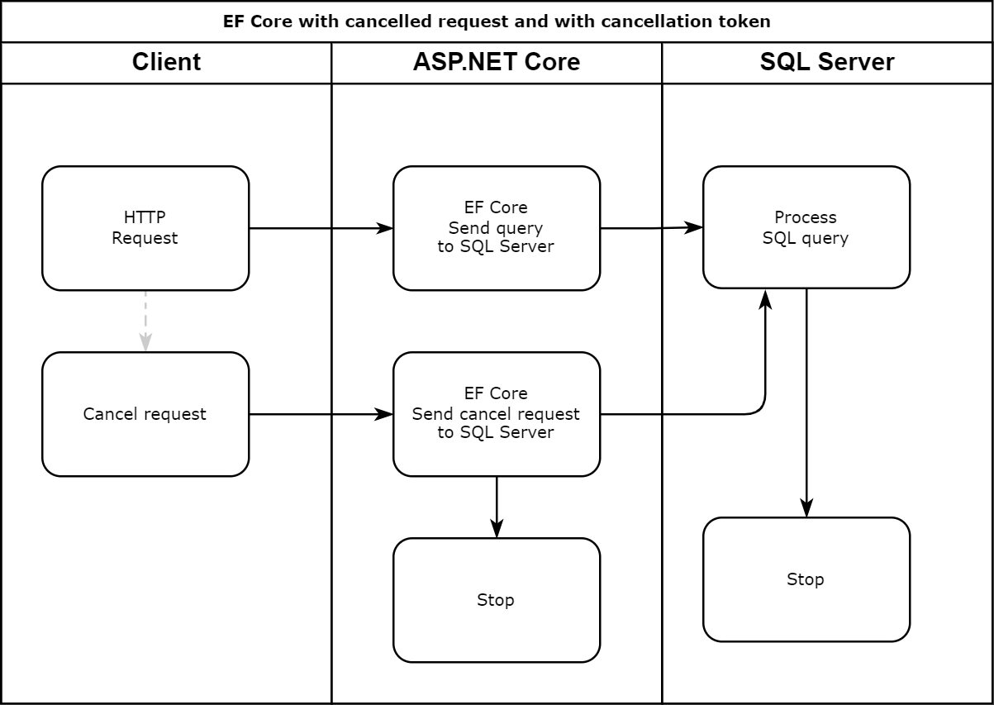
#7 How it works cancellation token?

Slide 59
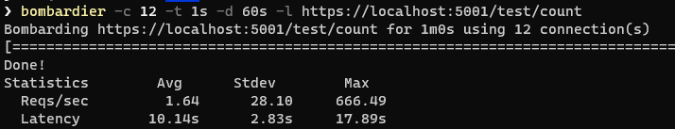
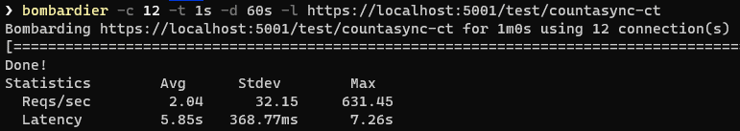
#7 Load test
~2x faster on average in a load test!
Also, responsiveness returns 40 seconds faster

Slide 60

Mini Best Practices

Slide 61
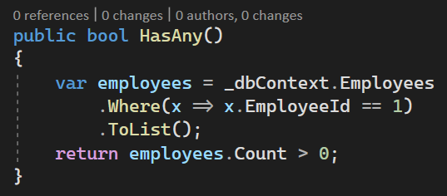
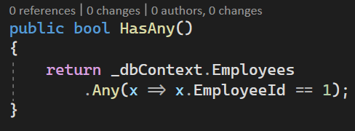
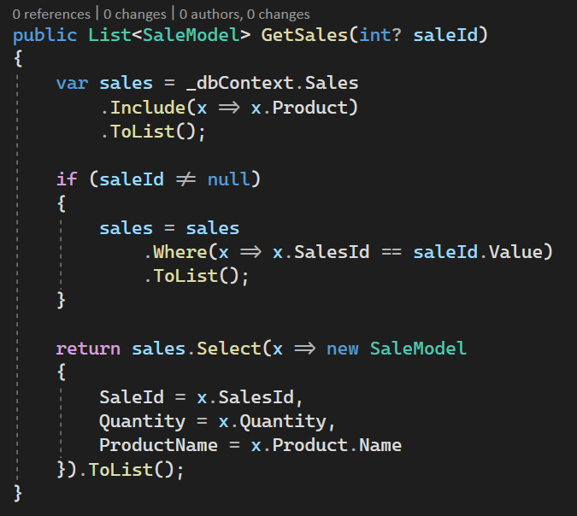
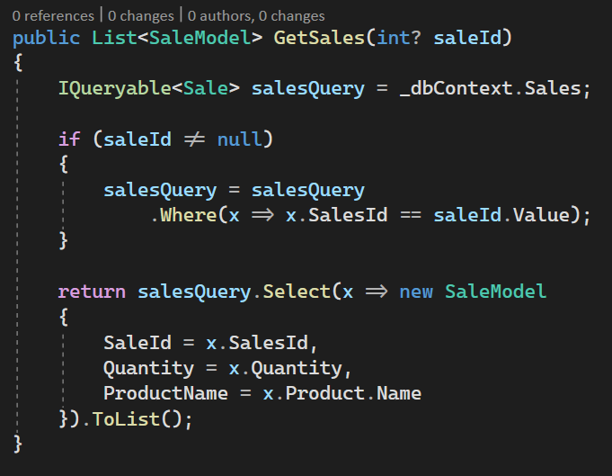
Bonus #1 - Other things I have seen

Slide 62
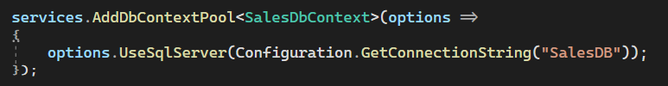
Bonus #2
DbContextPool
Reuses existing DbContext
Fewer connections to SQL Server
Improves resiliency

Slide 63
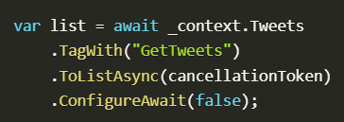
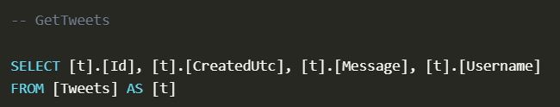
Bonus #3
TagWith
Adds comments into SQL query for easier debugging

Slide 64
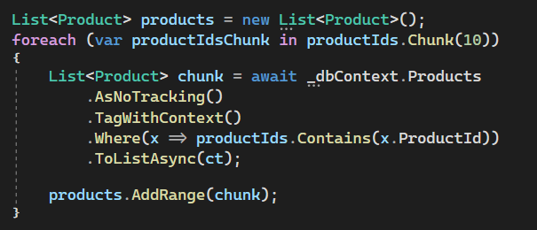
Bonus #4
Bulk processing in chunks
When querying and updating, bulk updates in smaller chunks
Large bulk inserts/updates can take much longer than small bulk inserts/updates

Slide 65
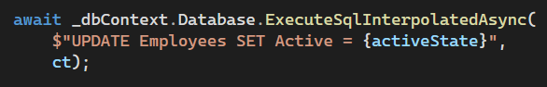
Bonus #5
Sometimes raw SQL is good
Updating lots of rows with simple set

Slide 66
Key takeaways
IEnumerable is dangerous when using with EF Core
AsNoTracking has massive perf impact
Make sure you don’t need to update/delete the entities
Simpler code can result in better perf

Slide 67
Resources
Source code for examples and benchmarking
github.com/jernejk/EFCoreSamples.StabilityAndPerformance
Microsoft resources for better EF Core performance
docs.microsoft.com/en-us/ef/core/performance/
Rules to Better Entity Framework
ssw.com.au/rules/rules-to-better-entity-framework
Rules to Better LINQ
ssw.com.au/rules/rules-to-better-linq
Notes:
Tip: Resources indicates that you’re nearing the end of your presentation

Slide 68




Scan the QR code below and earn
SSW Points for watching this talk!

Slide 69

Got feedback?
Scan the QR code here
to fill our survey.
How to Use this PowerPoint with Adam Cogan

Slide 70
Summary
Intro
The 7 Deadly Sins
Mini Best Practices

Slide 71
Summary
1. Select this shape object
2. Drawing Tools | Format | Shape Fill
3. Change to red
4. Only one of these should be red
5. Recommended selected color is SSW Red
6. Delete Extra Segments (Have no more than 6 chapters)
Notes:
Tip: Just copy your Agenda slide and change one word (From Agenda to Summary)

Slide 72
Find this presentation on GitHub!
github.com/sswconsulting/presentations
Notes:
https://www.ssw.com.au/rules/do-you-keep-your-presentations-in-a-public-location
Example slides: https://github.com/Hona/BlastOffWithBlazor.Demos/raw/main/Presentation.pptx

Slide 73

Thank you! info@ssw.com.au www.ssw.com.au Sydney | Melbourne | Brisbane
Notes:
Note: You should say “thank you” and then pause for 4-5 seconds… to give the audience time to applaud!
https://www.ssw.com.au/rules/do-you-finish-your-presentation-with-a-thank-you-slide

Slide 74
Questions? info@ssw.com.au www.ssw.com.au Sydney | Melbourne | Brisbane
Notes:
Note: You should pause for applause here!
https://www.ssw.com.au/rules/do-you-finish-your-presentation-with-a-thank-you-slide

